Slide 1
COUNTRY CLUSTERING FOR NGO
Verzeo main project
Made by:
Chaitrali Hunnur
Data Science Pro-degree
Batch B3

Slide 2
Problem Statement
Help an NGO that is committed to fighting poverty and providing the people of backward countries with basic amenities and relief during the time of disasters and natural calamities. The CEO of the NGO needs to decide how to use this money strategically and effectively. The significant issues that come while making this decision are mostly related to choosing the countries that are in the direst need of aid.
And this is where you come in as a data analyst. Your job is to categorize the countries using some socio-economic and health factors that determine the overall development of the country. Then you need to suggest the countries which the CEO needs to focus on the most.

Slide 3
Objectives
To categorise the countries using some socio-economic and health factors that determine the overall development of the country.
To suggest the countries which the CEO needs to focus on the most.

Slide 4
Data used
The data used is a data having the details of 168 countries.
The details include child mortality, imports, health, exports, inflation, income, life expectancy, total fertility and the gdp of these countries.

Slide 5
Method
Data Processing:
It was found that there were no null values.
There were a few outliers and they were treated.
The data was standardized for Principal Component Analysis.
The column having percentage values were converted to absolute values.

Slide 6
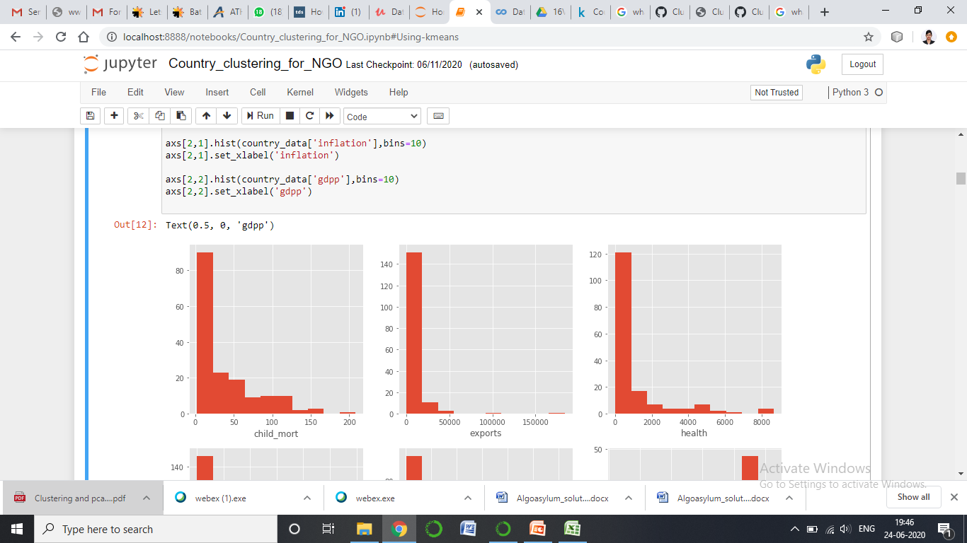
Method
Univariate analysis:
Histograms were plotted for all the 10 features.
Example:
This histogram of child mortality shows us that the maximum data points lie within the range of 0-65.

Slide 7
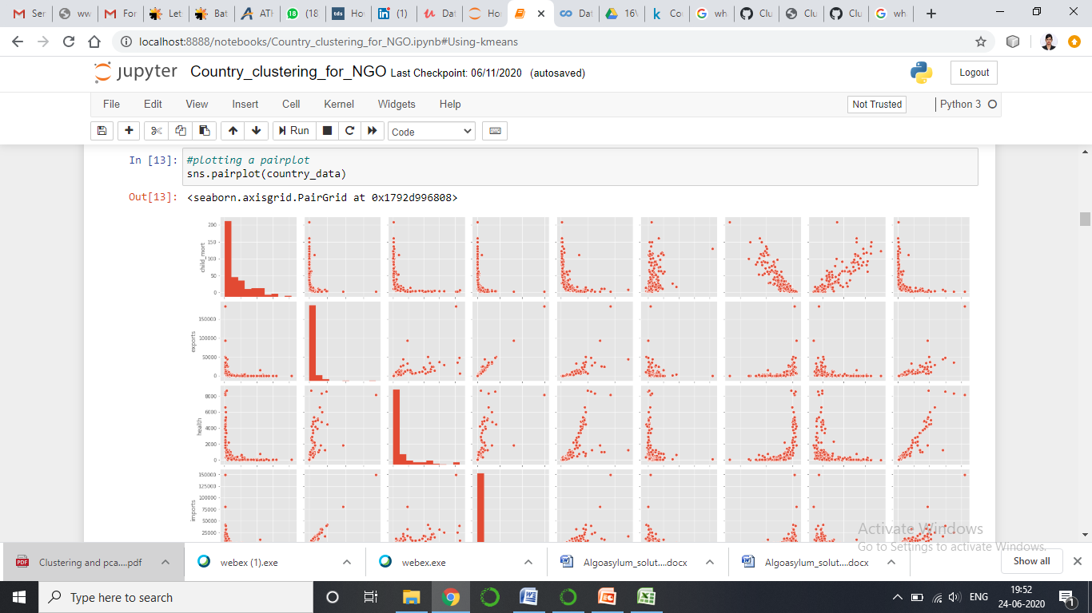
Method
Bivariate analysis:
We plot the pairplot for the pair wise relationships.

Slide 8
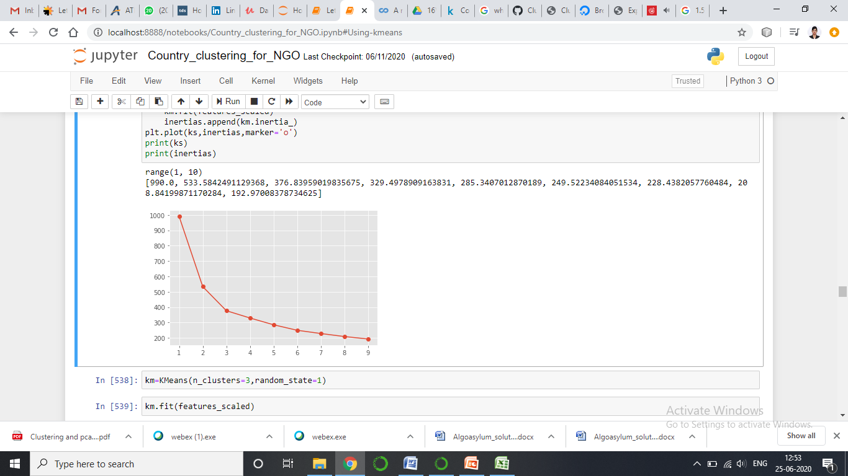
K-means clustering
After plotting the plot for 10 different values of k, we find the elbow at 3.
So we have chosen the number of clusters to be 3.

Slide 9
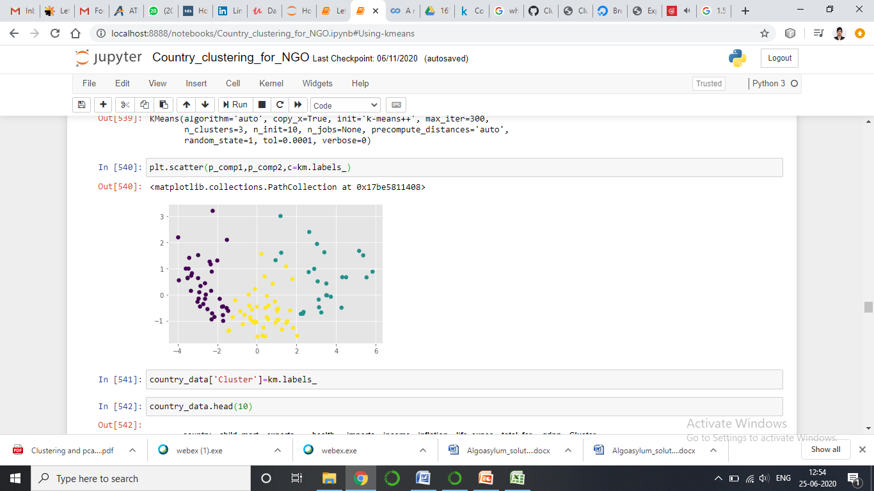
Plotting the clusters
Three different clusters

Slide 10
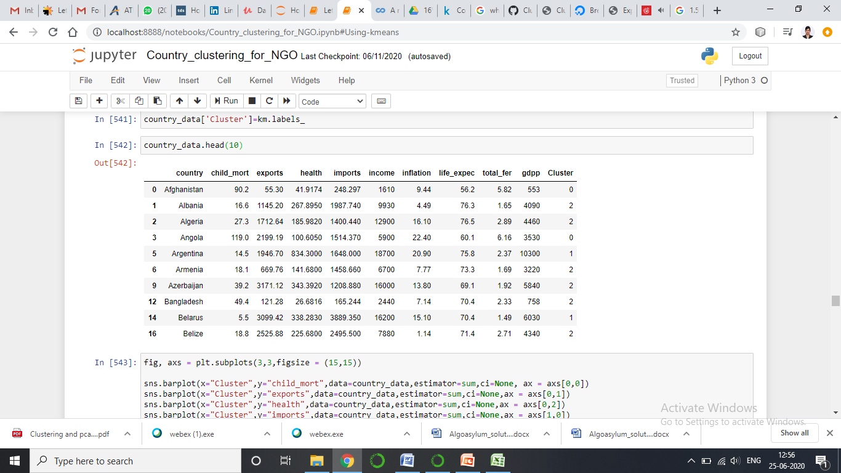
After k-means clustering
Countries are clustered in 3 clusters- 0, 1 and 2.
The Cluster column is added according to the k-means clusters.

Slide 11
Choosing the required cluster according to k-means
Among the three clusters, the cluster of countries that requires the maximum attention is cluster 0 because its exports, imports, expenditure on health, income as well as gdpp are the least whereas the fertility and life expectancy are very high.
Hence, thought the population keeps increasing they do not have enough funds.

Slide 12
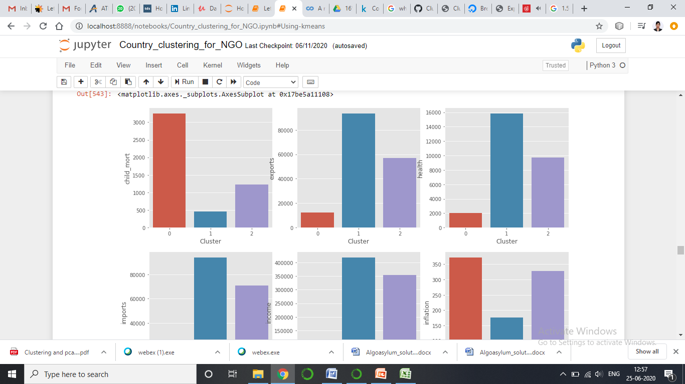
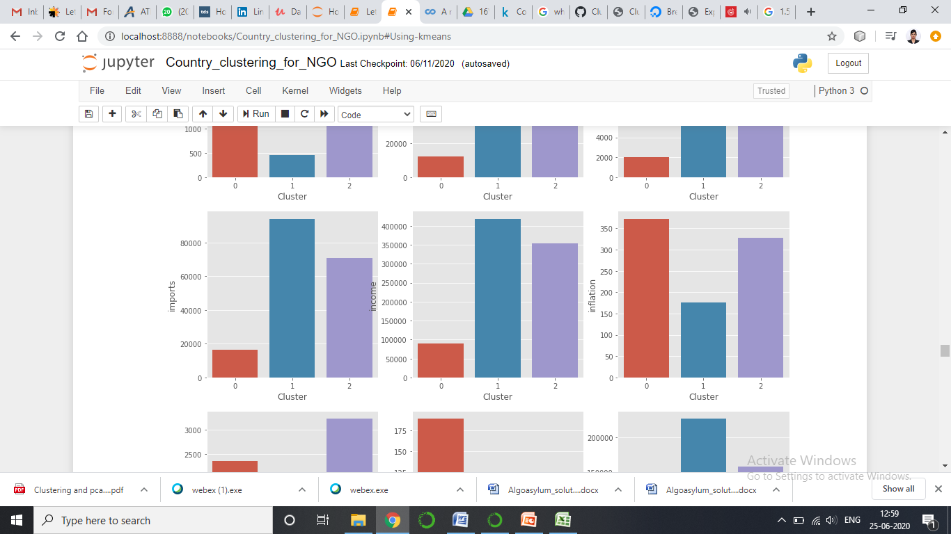
Least exports
Least health expenditure
Least imports

Slide 13
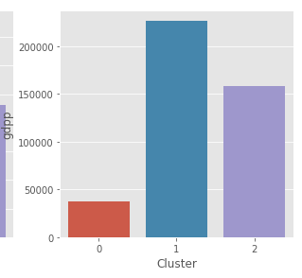
Least income
Least gdpp

Slide 14
RESULT: Countries in Cluster-0
Afghanistan, Angola, Benin, Burkina Faso, Burundi, Cameroon, Comoros, Congo, Dem. Rep., Congo, Rep., Cote d'Ivoire, Eritrea, Gambia, Ghana, Guinea, Guinea-Bissau, Kenya, Kiribati, Lao, Lesotho, Liberia, Madagascar, Malawi, Mali, Mauritania, Mozambique, Niger, Pakistan, Rwanda, Senegal, Solomon Islands, Sudan, Tajikistan, Tanzania, Togo, Uganda, Yemen, Zambia

Slide 15
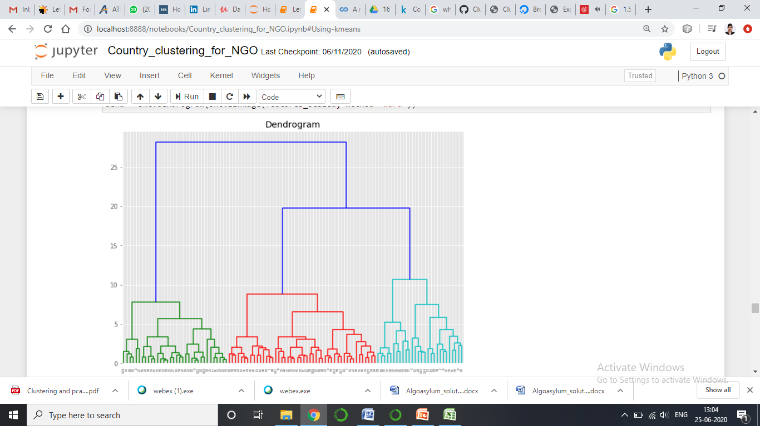
Hierarchical Clustering
From the dendogram shown below, we have chosen the number of clusters as 4.

Slide 16
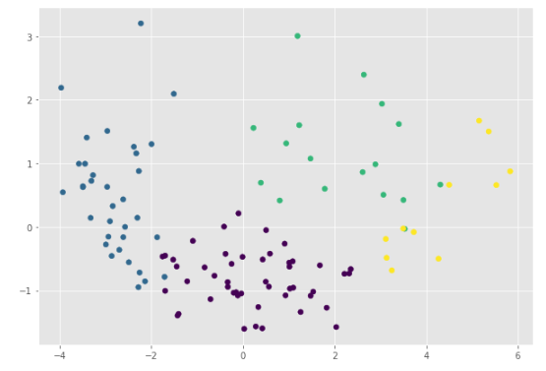
Plotting the clusters

Slide 17
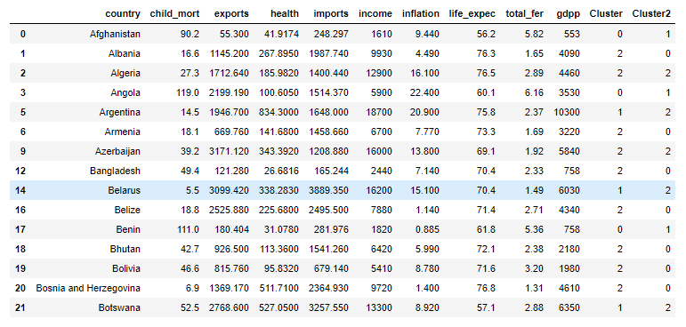
After hierarchical clustering
Countries are clustered in 4 clusters- 0, 1, 2 and 3.
The Cluster2 column is added according to the hierarchical clusters.

Slide 18
Choosing the required cluster according to hierarchical clustering
Among the four clusters, the cluster of countries that requires the maximum attention is cluster 1 because its exports, imports, expenditure on health, income as well as gdpp are the least whereas the fertility and life expectancy are very high.
Hence, thought the population keeps increasing they do not enough funds

Slide 19
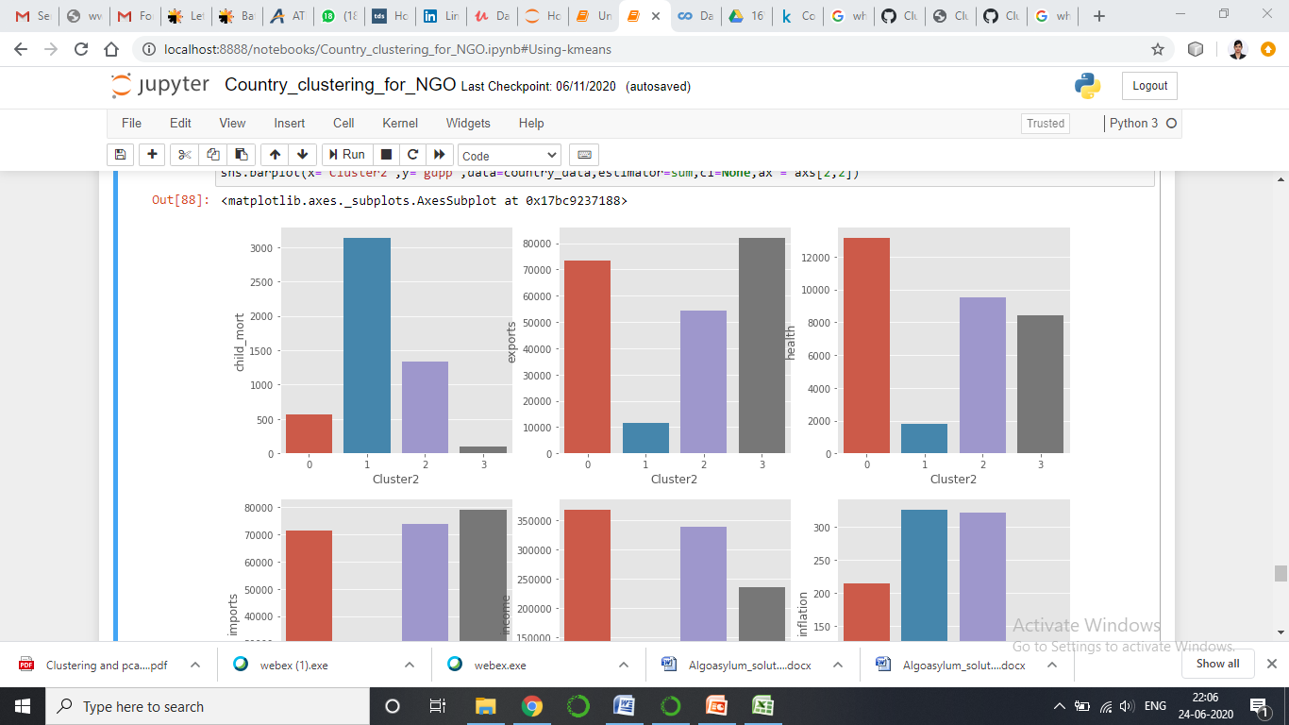
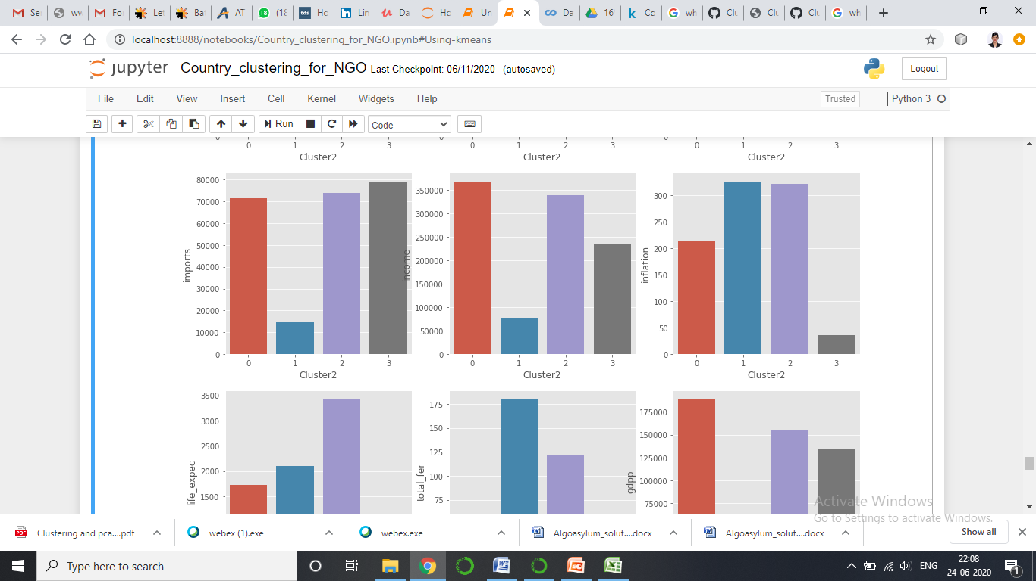
Least exports
Least health expenditure
Least Imports

Slide 20
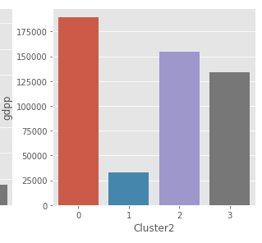
Least Income
Least gdpp

Slide 21
RESULT: Countries in Cluster-1
Afghanistan, Angola, Benin, Burkina Faso, Burundi, Cameroon, Comoros, Congo, Dem. Rep., Congo, Rep., Cote d'Ivoire, Eritrea, Gambia, Ghana, Guinea, Guinea-Bissau, Kenya, Kiribati, Lao, Lesotho, Liberia, Madagascar, Malawi, Mali, Mauritania, Mozambique, Niger, Pakistan, Rwanda, Senegal, Sudan, Tanzania, Togo, Uganda, Yemen, Zambia

Slide 22
CONCLUSION
The countries that need the most attention are:
Afghanistan, Angola, Benin, Burkina Faso, Burundi, Cameroon, Comoros, Congo, Dem. Rep., Congo, Rep., Cote d'Ivoire, Eritrea, Gambia, Ghana, Guinea, Guinea-Bissau, Kenya, Kiribati, Lao, Lesotho, Liberia, Madagascar, Malawi, Mali, Mauritania, Mozambique, Niger, Pakistan, Rwanda, Senegal, Sudan, Tanzania, Togo, Uganda, Yemen, Zambia
These countries have a very less income rate per person, less imports and exports, less expenditure on health and the least gdp per capita.
They have a very high measurement of annual growth rate, total fertility and the average life expectancy.
So it is very evident the these are the countries that require immediate aid in terms of money, education and services.

